Slide 1
Stacks and Queues

Slide 2
STACKS
A stack is a linear data structure that follows the principle of Last In First Out (LIFO). This means the last element inserted inside the stack is removed first.
You can think of the stack data structure as the pile of plates on top of another.

Slide 3
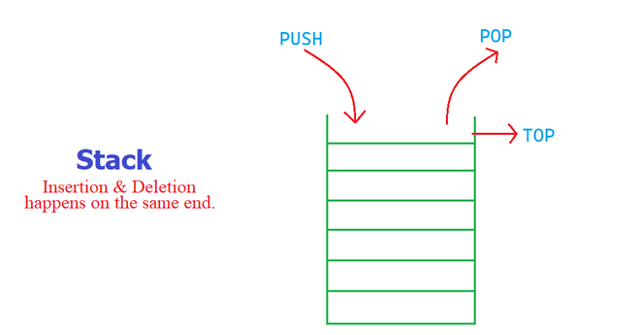

Slide 4
Basic Operations on Stacks
Push: Add an element to the top of a stack
Pop: Remove an element from the top of a stack
IsEmpty: Check if the stack is empty
IsFull: Check if the stack is full
Peek: Get the value of the top element without removing it

Slide 5
QUEUES
A Queue is a linear structure which follows a particular order in which the operations are performed. The order is First In First Out (FIFO). A good example of a queue is any queue of consumers for a resource where the consumer that came first is served first. The difference between stacks and queues is in removing. In a stack we remove the item the most recently added; in a queue, we remove the item the least recently added.

Slide 6
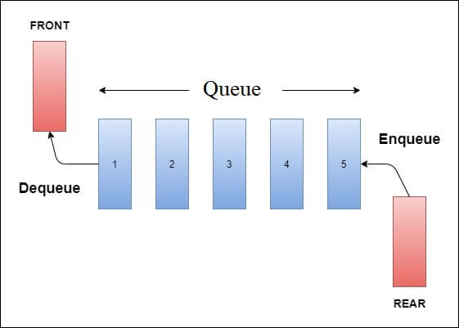

Slide 7
Basic Operations on Queues
enqueue() − add an item to the queue.
dequeue() − remove an item from the queue.
isfull() − Checks if the queue is full.
isempty() − Checks if the queue is empty.
getFront() – Returns element at front.
getRear() – Returns element at rear end.

